Slide 1







Analysis of Mental Health Dynamics
Code Repo: https://github.com/Intro-to-Data-Science-Team-10/Mental-Health-Dynamics-Analysis
Team 10
DSCI – 6002 – 01
Final Project
University of New Haven
West Haven, CT
Team Members
Amjad Ali Team Leader Data Analysis & Modeling
Karthik Vinnakota Data Analysis
Parin Patel Storytelling & Data Visualization
Ramya Chava Data Exploration

Slide 2

Team Members
Amjad Ali Team Leader Data Analysis & Modeling
Karthik Vinnakota Data Analysis
Evaluating The Impact Of A Health Inervention Program
Parin Patel Storytelling & Data Visualization
Ramya Chava Data Exploration
Problem :

Slide 3

Team Members
Objective:
Problem Statement:
Amjad Ali Team Leader Data Analysis & Modeling
The primary aim of this project is to uncover patterns and relationships that provide valuable insights into the complex dynamics of mental well-being across diverse individuals. The goal is to understand how personality traits, specifically those measured by the Ten Item Personality Inventory (TIPI), and demographic factors influence mental health outcomes, as measured by the Depression, Anxiety, and Stress Scales (DASS).
Karthik Vinnakota Data Analysis
Parin Patel Storytelling & Data Visualization
Ramya Chava Data Exploration
The objective is to create a comprehensive system that can predict mental health outcomes, identify potential risk factors, and provide insights into the dynamic nature of mental well-being over time. This project aims to contribute to the development of personalized interventions and support systems to improve mental health outcomes for individuals.

Slide 4

Team Members
Objective:
The objective is two-fold:
The first objective is to check the impact of TIPI i.e. Ten Item Personality Inventory on the DASS scores (ratings given by different users for Q1 – Q42). TIPI 4 was the strongest variable to check the impact of anxiety over various DASS scores.
The second objective is to use statistical techniques like ANOVA (ANalysis Of VAriance) to check if there is any statistical difference in the mean DASS scores among individuals with varying levels of anxiety, as measured by TIPI4. The second ANOVA test was to check if there is any statistical difference in the demographics (age, gender) with TIPI4.

Slide 5
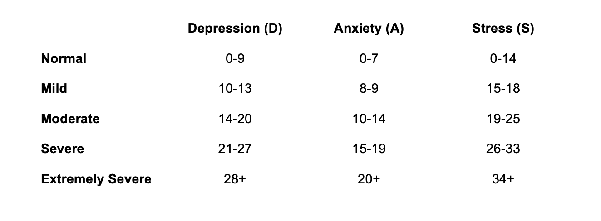
Team Members
Objective:
What is DASS?
Amjad Ali Team Leader Data Analysis & Modeling
The Depression, Anxiety, and Stress Scale (DASS) is a widely used self-report psychological assessment tool designed to measure the severity of symptoms related to depression, anxiety, and stress in individuals.
It has shown to have good reliability and validity, making it a robust tool for assessing mental health.
Incorporating DASS into a data science project can provide valuable insights into mental health trends and help identify patterns or risk factors associated with these conditions.
Karthik Vinnakota Data Analysis
Parin Patel Storytelling & Data Visualization
Ramya Chava Data Exploration
The objective is to create a comprehensive system that can predict mental health outcomes, identify potential risk factors, and provide insights into the dynamic nature of mental well-being over time. This project aims to contribute to the development of personalized interventions and support systems to improve mental health outcomes for individuals.

Slide 6




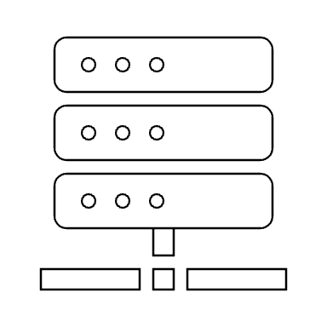


Roadmap/ Project Plan
7. Using the best model to evaluate DASS
1. Data Collection
3. Data
Preprocessing
5. Creating different models to compare
9. Drawing Conclusions
8. Hypothesis test using ANOVA
2. Data
Cleaning
4. Visuals of Clean Data
6. Choosing the model with best accuracy

Slide 7
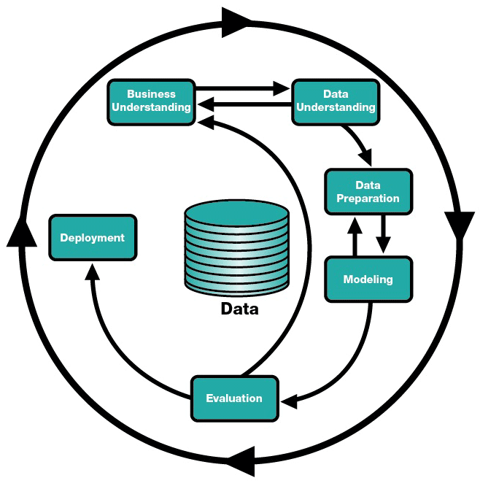
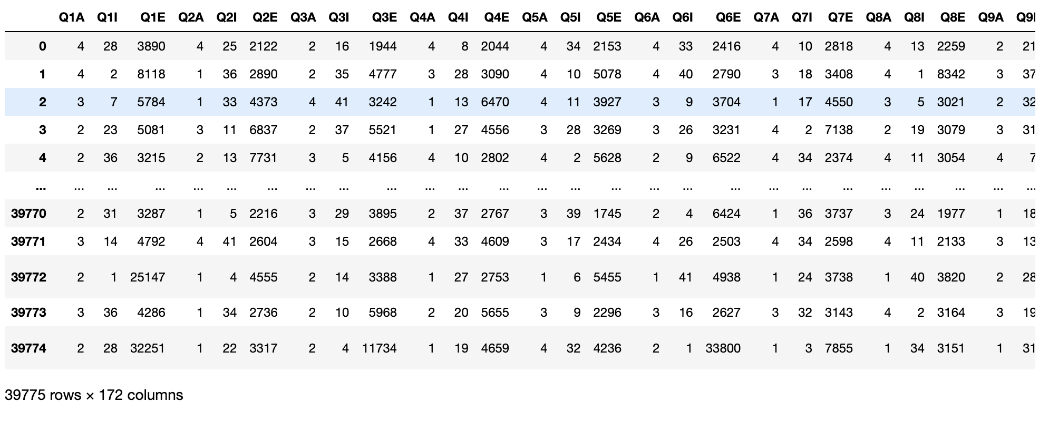
Dataset Used:
Source file: Depression Anxiety Stress Scales Responses
(Open-sourced raw data from openpsychometrics.org)
Kaggle link: https://www.kaggle.com/datasets/lucasgreenwell/depression-anxiety-stress-scales-responses/
Dataset Description / Summary
This data was collected with an on-line version of the Depression Anxiety Stress Scales (DASS).
It consists of Questions, answers, and metadata collected from 39775 Depression Anxiety Stress Scales.
Process Model: CRISP-DM
Methodology

Slide 8
Process Model: CRISP-DM
Methodology

Slide 9
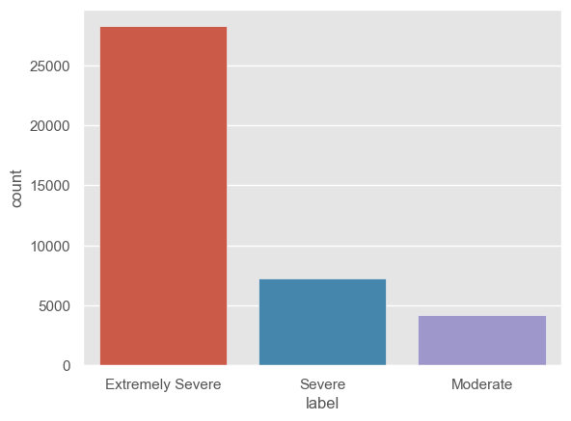
Visualizations:
Fig – Categorizing the users responses from Q1 to Q42 into 5 labels – Extremely Severe, Severe, Moderate, Mild and Normal. Here all the users response falls into the three categories.

Slide 10
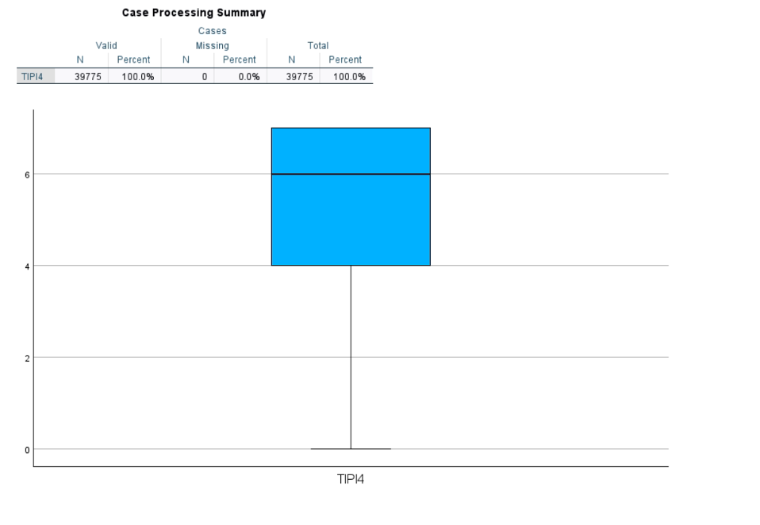
Visualizations:
Boxplot summary that defines n = 39775 and is a strong variable of anxiety that we have used in ANOVA to determine if the means of TIPI4 is same / equal to 0 to the means of all the DASS scores or not.

Slide 11
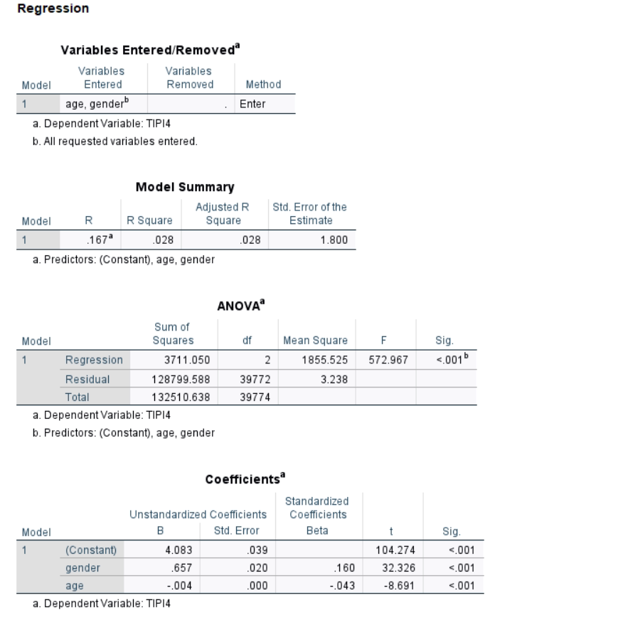
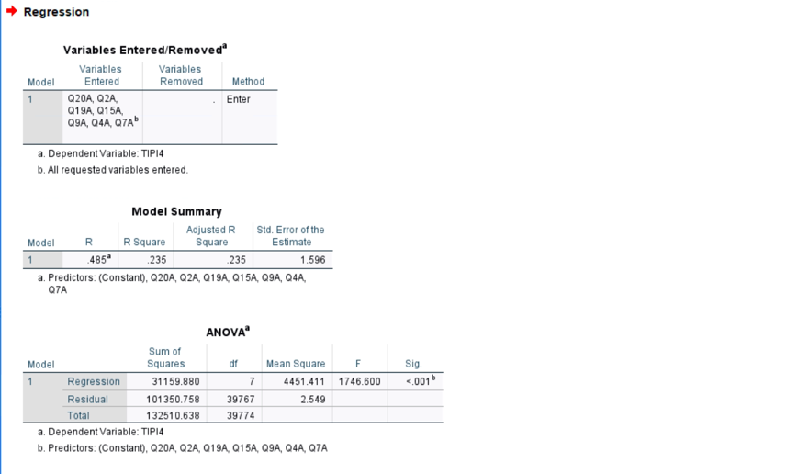
Understanding Results/Output:
Hypothesis Testing Using ANOVA
Problem 2
Problem 1

Slide 12
Understanding Results/Output:
Comparing the ML Model Accuracies -
 | precision | recall | f1-score | support
Extremely Severe | 0.78 | 0.96 | 0.86 | 9919
Moderate | 0.51 | 0.42 | 0.46 | 1466
Severe | 0.36 | 0.08 | 0.14 | 2527
accuracy |  |  | 0.74 | 13912
Macro avg | 0.55 | 0.49 | 0.48 | 13912
 | precision | recall | f1-score | support
Extremely Severe | 0.81 | 0.89 | 0.85 | 9919
Moderate | 0.43 | 0.38 | 0.40 | 1466
Severe | 0.33 | 0.22 | 0.26 | 2527
accuracy |  |  | 0.71 | 13912
Macro avg | 0.52 | 0.49 | 0.50 | 13912
Logistic Regression
Random Forest
 | precision | recall | f1-score | support
Extremely Severe | 0.80 | 0.89 | 0.84 | 9839
Moderate | 0.45 | 0.37 | 0.40 | 1508
Severe | 0.32 | 0.21 | 0.26 | 2565
accuracy |  |  | 0.71 | 13912
Macro avg | 0.52 | 0.49 | 0.50 | 13912
SVM

Slide 13
Conclusion
The analysis conducted to investigate the associations between demographic variables and mental health outcomes, as measured by the Depression, Anxiety, and Stress Scales (DASS), yielded insightful findings.
The statistical tests, including ANOVA or regression analysis (based on the nature of the data), provided robust evidence for the presence of significant associations between at least one demographic variable and mental health outcomes.
The strengths of Logistic Regression, including its simplicity, interpretability, and efficiency in capturing linear relationships, positioned it as the optimal choice for predicting mental health outcomes in this study.
While Random Forest and SVM demonstrated commendable performance, the interpretability and transparency offered by Logistic Regression make it a pragmatic choice in a clinical or decision-making context.

Slide 14

Thank You

